Slide 1
Generator Energy Storage Integrated System (GENESIS)
Electrical Accumulator Unit (EAU)
Preliminary Design Review
(PDR)
January 14, 2020
WARNING - This document contains technical data whose export is restricted by the Arms Export Control Act (Title 22, U.S. C., Sec 2751, et seq.) International Traffic in Arms Regulations (ITAR). Disclosure to foreign persons without prior U.S. Government approval is prohibited. Violations of these export laws/regulations are subject to severe criminal penalties.

Slide 2
Introductions/Agenda (Times are EST)

Slide 3
PDR Objectives
Review progress made since SRR.
Present data/methods being implemented to arrive at the final design including:
DC/DC Converter trade-offs
Capacitor trade-offs
Capacitor Management System trade-offs
FP note: System Mass & size estimates
ICD
GUI
Machine states
Simulation models (Output response & RB Note: Executable System Driver?)
Review requirements metrics; compliance and verification.
Identify program risk and opportunities.
Program management including schedule, staffing, deliverables and action items.

Slide 4
Program Overview

Slide 5
FP note: Summary of Requirements - 1
Frank P add content
RB note: I placed “Summary of Requirements – 1” as title, I believe that was FP’s intent

Slide 6
Summary of Requirements - 2
Frank P to add content
RB note: I placed “Summary of Requirements – 2” as title, I believe that was FP’s intent

Slide 7
Results Of Trade Studies

Slide 8
DC-DC Converter (MarcoA to add content)
FP note: – Why this type of DC-DC versus another

Slide 9
System Performance
Take-aways from HESM trade-study results:
For high-pulse power applications with short time-duration such as GENESIS EAU and HESM, actual amount of energy storage (capacitance) is unimportant. Only low ESR matters to maximize terminal voltage during high power load transients
In such applications, ultracapacitors with lowest Mass and ESR product win (smallest size, lowest loss, smallest converter)
Adding capacitors is significantly cheaper/smaller than adding converter phase legs (i.e., higher ESD voltage vs. additional converter current capability)
System Power Loss vs. Weight
1s Peak RMS Current vs. Weight

Slide 10
DC-DC Converter, Topology
Property | Buck Converter | Boost Converter | Boost-Buck Converter (Traditional) | Isolated Converter | 4-Switch Bi-Directional Buck-Boost Converter
Bi-Directionality | Yes | Yes | Yes | Yes | Yes
ESD Voltage Range | V_{dc} up to device limits. Can yield undesirably high dc voltages at high altitudes | Ideally 0 to V_{dc} Realistic about 1:3 boost ratio | Ideally 0 to device limits Switches see V_{dc} + V_{ESD} Results in high voltages at high altitude | Up to device limits, no restrictions | Same as boost converter
Size / Mass | Small (single phase-leg, inductor) | Small (single phase-leg, inductor) | Small (single phase leg, inductor) | Big (four phase-legs plus HF transformer) | Medium (requires additional phase leg)
Converter Loss | Low | Low | High (high switching loss as devices see V_{dc} + V_{ESD}) | Low to medium, depending on control implementation | Low (additional phase leg is conduction loss only)
Simplicity (Control, Impl.) | Simple, but may require ESD precharge | Simple | Simple | Complex | Simple
Short-Circuit, Bus | Full control of current | Diode path, no control | Full control of current | Full control of current | Full control of current
Short-Circuit, ESD | Diode path, no control | Full control of current | Full control of current | Full control of current | Full control of current
EAU Converter Topology
PCKA’s EAU hardware has traditionally utilized a boost converter as it provides best utilization of ultracapacitor energy storage. However, in previous applications the short-circuit behavior of the converter was determined to be acceptable or, in some cases, desirable, with short-circuit considerations handled at a system level.
EAU converter will be a 4-switch bi-directional buck-boost converter, which allows same advantages as boost converter but addresses short-circuit current feeding requirements (full control of current into short through buck-portion of converter)
EAU converter will operate in boost-mode under normal operation and in buck-mode when bus voltage is lower than ESD voltage
Topology doubles number of device phase-legs, but only marginally increases loss as only one phase-leg is actively switching. Size/weight is also only affected marginally as EMI-filter remains the same

Slide 11
DC-DC Converter, Sizing
Trade-off between dc-dc converter and ESD size
Each dc-dc converter GaN phase leg can approximately handle 150 A peak current for 50 – 100 ms
Each phase-leg adds about 1.5 kg of weight to the converter (incl. inductor, heatsink, housing increase)
Ultracapacitor cells are assumed to be operated at 2.55 V_{dc} (2.7 V_{dc} max)
Yunasko 1200 F ultracapacitor cell has 0.3 kg weight, 0.3 mΩ ESR (includes connection resistance)
Constraints:
At this time, cannot have more than 8 phase-legs per converter power stage module without additional size/weight penalty
Limit max. ultracapacitor bank voltage to 250 V_{dc} to allow control headroom into 270 V_{dc} bus
Trade-Off Converter vs. Ultracapacitor Size
UC Terminal Voltage and Current vs. Size
Note:
Mass number is combined phase-legs and ultracapacitors, but represents only active portion and does not include housing and auxiliary components (fixed mass).

Slide 12
Energy Storage Device (ESD) (FrankP to add content)
FP note: – Comparison of capacitor types

Slide 13
Energy Storage Device (ESD) Capacitor Trade-Offs and Selection

Slide 14
The total power requirements are thus the startup and turn off the DEW and the DEW and the noise suppression requirements
For the 36kW noise requirement, we assume a 41kW total pull from the ESD (+14%) from the EAU
For the 150kW DEW, we assume 180kW from the EAU
We also note that the noise suppression during the DEW pulse is reduced.

Slide 15
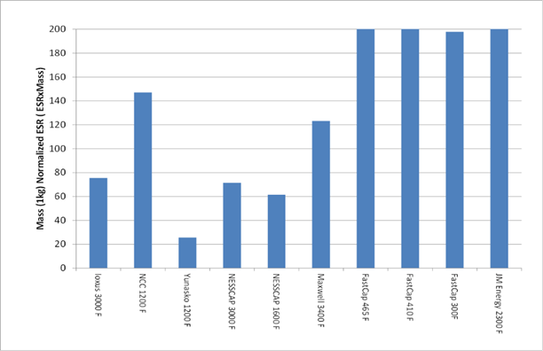
Noise Current (at 41kW)
24in wide

Slide 16
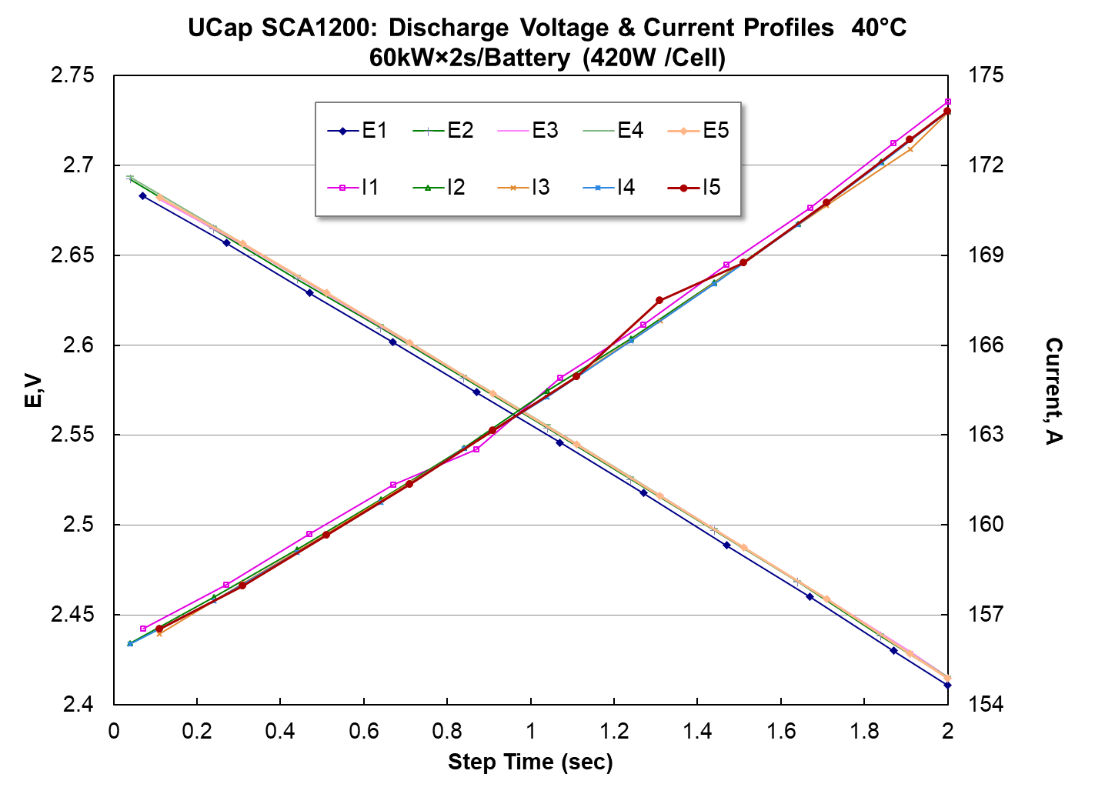
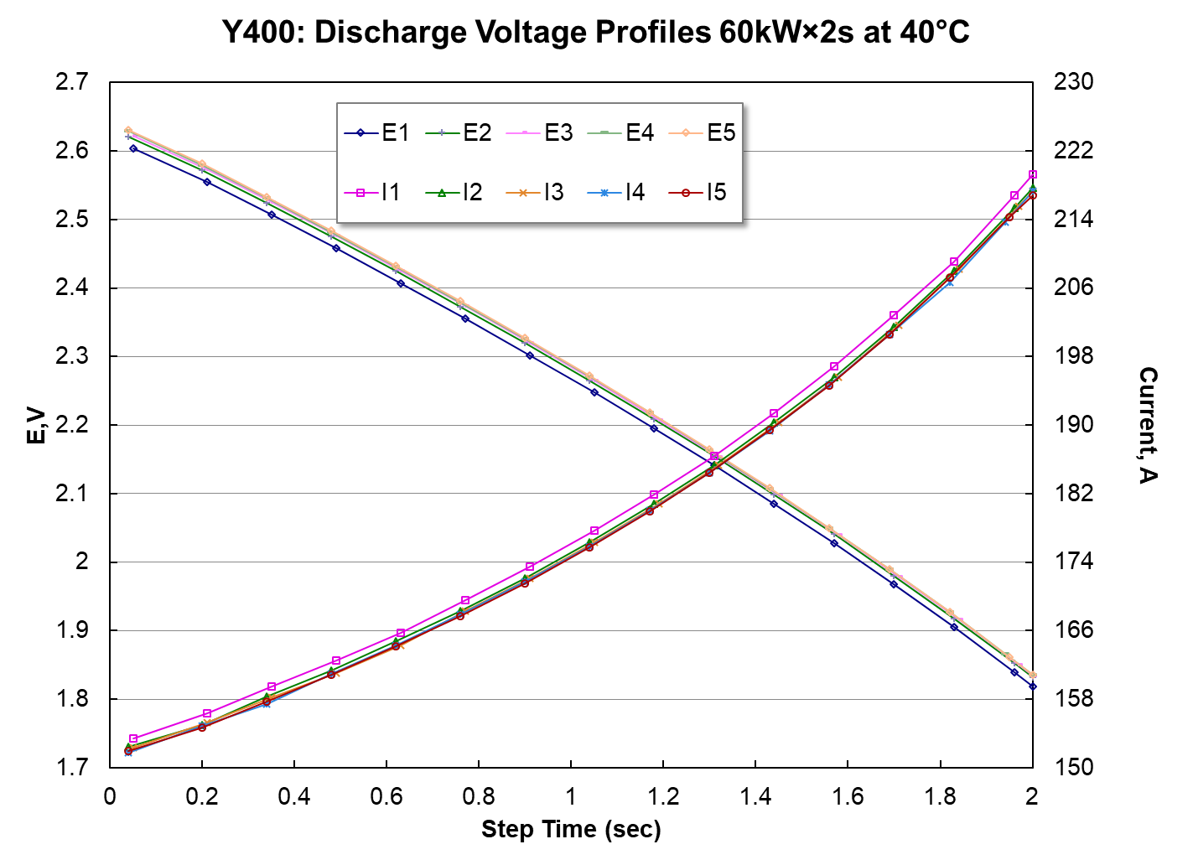
50mV delta at start of discharge but 150mV OCV delta

Slide 17

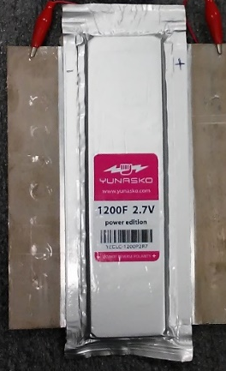
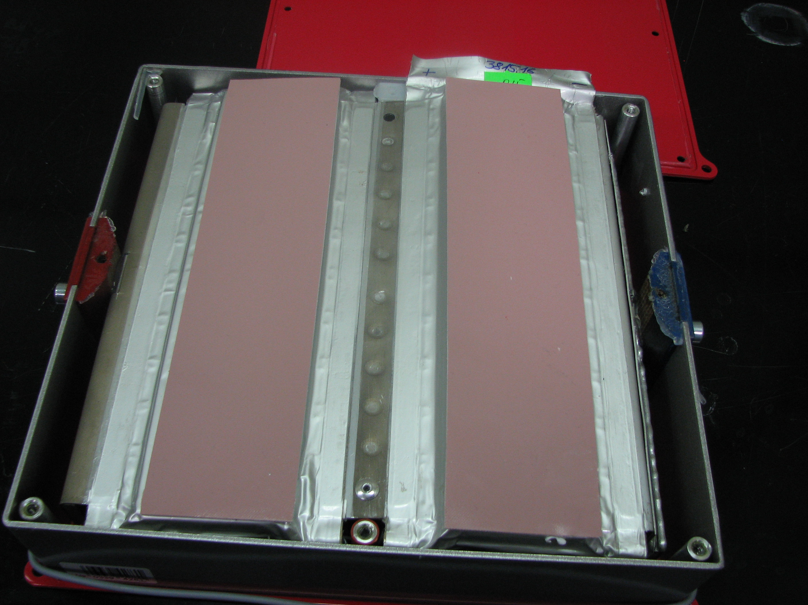
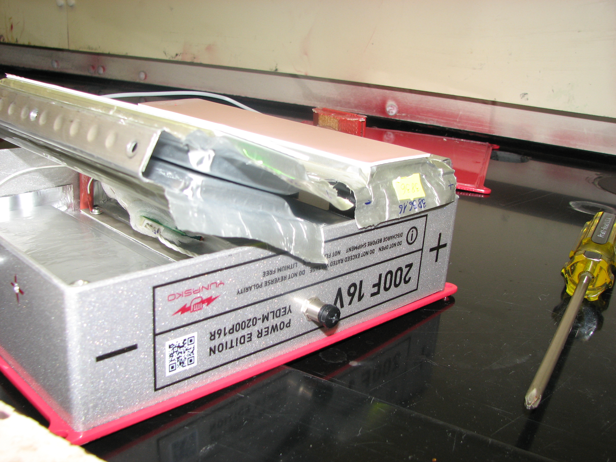
Intercells
The Skeleton Caps require an intercell connector. The Yunasko’s do not

Slide 18
Vacuum

Slide 19
From
From this initial chart we were able to downselect to the Skeleton and Yunasko Capacitors
The customer indicated that cooling the capacitor bank was not desired.
Because we had the ESR, and a duty cycle, and a mass and a heat capacity we were able to calculate the adiabatic temperature rise rate

Slide 20
Average Current
From this initial chart we were able to downselect to the Skeleton and Yunasko Capacitors
The customer indicated that cooling the capacitor bank was not desired.
Because we had the ESR, and a duty cycle, and a mass and a heat capacity we were able to calculate the adiabatic temperature rise rate

Slide 21
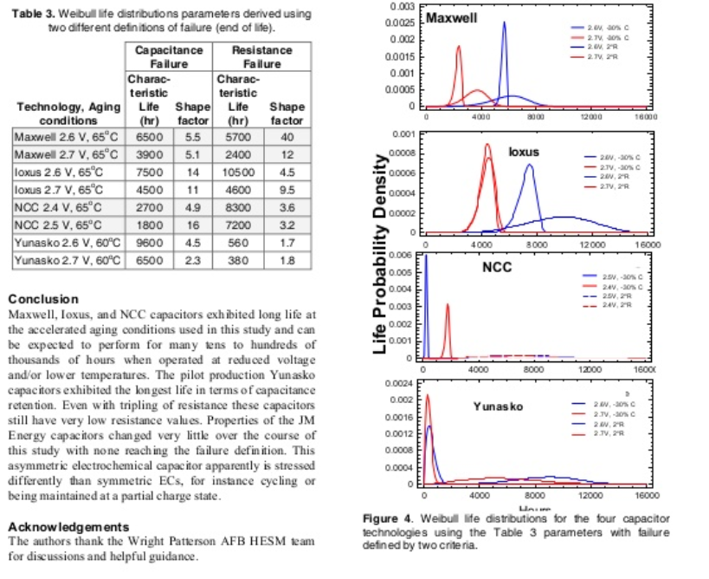

Slide 22
Adiabatic Run time
Longer runtimes are likely to deviate from adiabatic more.
37 min
19 min

Slide 23
Review Of Preliminary Design

Slide 24
DC-DC Converter (MarcoA to add content)

Slide 25
EAU Concept Diagram

Slide 26
DC-DC Converter Module Diagram

Slide 27
DC-DC Converter, Components
Component | Description | Part Number / Series | Supplier
Power Stage Module (PSM) | GaN-based, 8 phase-leg, including measurements | PCA_PCKA_146C | PCKA
Primary Filter Inductors | Nanocrystalline inductors, custom | TBD | MK Magnetics
EMI-Filter, ESD | ESD-side DM and CM EMI-Filter, PCB based | TBD | PCKA
EMI-Filter, 270 V Bus | Bus-side DM and CM EMI-Filter, PCB based | TBD | PCKA
Main Control Module (MCM) | DSP control PCB, based on TI TMS320F28377D | PCA_PCKA_138A | PCKA
Peripheral Expansion Module (PEM) | PCB between MCM and peripheral equipment. Controls contactors, isolates digital I/O lines, analog measurements, and communication | TBD | PCKA
Control Power Module (CPM) | Isolated 24 Vdc for EAU internal, derived from 28 V, 270 V, and/or ESD voltage | TBD | PCKA
MLC | Main-line contactor | KHR503 | TE Connectivity
Current sensor (int. & ext.) | Current sensor, closed-loop hall effect, +/- 1000 A | LF 1010-S | LEM
Heatsink | Micro-channel coldplate, custom aluminum, interfacing with PSM, primary inductors | TBD | Wieland Microcool
Power Connectors | Single-pole. 500 A power connectors with straight exit option | HBB Series | Smiths Interconnect
Signal Connectors | Circular connectors, D38999 Series III, M-Series (EN-plated composite) | D38999/XXM | Wesco Aircraft
Indicators | LED, 8mm, panel mount, IP67 | Q8 Series | APEM / PEI Genesis
Housing | Aluminum, black anodized MIL-A-8625, Type 2, Class 2 | TBD | TBD
Sealing | O-ring, Fluorosilicone (-62 to 205ºC) | TBD | McMaster
Pressure Equalizer | Gore PolyVent stainless steel (-40 to 125ºC) | PMF200444 | Sealing Devices

Slide 28
DC-DC Converter, CAD Model
Converter box, with and without lid
Mass
Front Panel layout (connectors, cooling)
How do we survive environment (conformal coating, sealing, venting)
How are performance requirements addressed (underlying design assumption, corner operating points)?

Slide 29
Capacitor Bank (FrankP to add content)

Slide 30
Capacitor Bank (FrankP to add content)

Slide 31
Capacitor Management System (CMS) (RayS to add content)
Architecture

Slide 32
State Diagram & Software Requirements

Slide 33
DC-DC Converter (MarcoA to provide Content)
MA Email Text from 20191231
“Slide 19: Software Requirements? I think software requirements refers to the simulation models, not the controls of the EAU (there is no software per se, it’s code implemented on a DSP)”

Slide 34
DC-DC Converter Control
Control state diagrams including
Startup
BIT, PBIT
Normal operation
Fault

Slide 35
Capacitor Management System (CMS) (RayS to provide content)

Slide 36
Simulation Models

Slide 37
DC-DC Converter (MarcoA to provide content)
Output response

Slide 38
EAU Simulation Model
Simulation results for expected load profiles
Electrical, Thermal
Software user manual

Slide 39
Preliminary Analysis Results

Slide 40
DC-DC Converter (MarcoA to provide Content)
Mass
Thermal
Reliability
Key parts volt/temp

Slide 41
DC-DC Converter, Weight
Weight roll-up
Derating of critical parts (none?)

Slide 42
DC-DC Converter, EMI-Filter
Filter performance simulations

Slide 43
DC-DC Converter, Thermal Analysis
Thermal performance simulations (coolant, junction, temps)

Slide 44
DC-DC Converter, Reliability Analysis
Reliability

Slide 45
Energy Storage Device (ESD) (FrankP & RayS to provide content)
Mass
Thermal
Reliability – FP note: – Work with Yunasko
Key parts volt/temp – FP note: – Work with ESL

Slide 46
Bio Break

Slide 47
CAD Models

Slide 48
EAU complete (RayS to provide content)

Slide 49
EAU ICD

Slide 50
EAU ICD (RayS to provide CONTENT)

Slide 51
GUIs

Slide 52
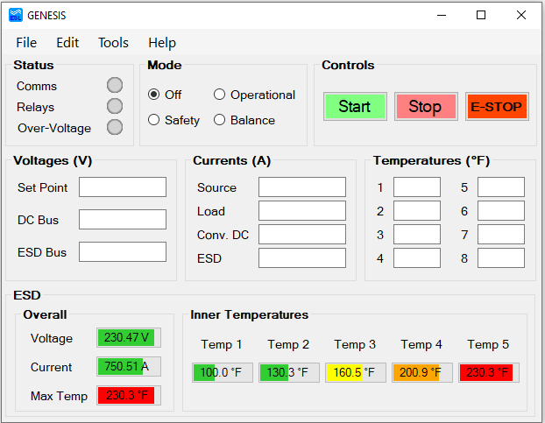
DC-DC Converter and ESD GUI (RayS to provide content)
Windows 10 based GUI
Visual Studio 2013
.Net Framework 4.7.2
Uses PCAN CAN/USB connection for comms
CAN connects to DC-DC Converter
USB connects to computer with GUI
500 kHz, Little Endian, MSB, Standard ID
Shows system status and mode
Controls the mode and operation of the system
Displays DC-DC Converter Info
PCKA to provide details
Displays ESD Info
Gauges display readings for capacitor bank
Path to aircraft [TBD]

Slide 53
GUI – Status, Mode, and Controls
Status LEDs
Comms
Gray: Disconnected
Green: Connected
Orange: Bus Heavy
Relays
Red: Closed
Green: Open
Over-Voltage
Red: A capacitor cell in the Yunasko capacitor bank is over its voltage limit

Slide 54
GUI – Status, Mode, and Controls
Modes to control behavior of DC-DC Conv.
Off – Allows discharge of cap bank to 50V in 2hrs < t < 24hrs
Balance – The DC Bus voltage is allowed to be above normal limits for 24hrs
Operational – Normal operation
Safety – ECMS enters safety mode when any limits are reached and opens the contactor
Controls
Start – Manually starts a discharge cycle
Stop – Manually stops the discharge cycle
E-STOP – Quickly stops system in case of emergency

Slide 55
GUI – ESD Information
Displays information given by the Yunasko capacitor bank using gauges
Voltage
Total voltage of all the capacitor bank’s cells
Current
Current provided by the capacitor bank
Max Temperature
Maximum temperature of inner temperatures
Temps 1 – 5
Temperatures of the capacitor cells in the capacitor bank
Temps 1 & 5: Readings near opposite ends of the bank
Temps 2 – 4: Readings from middle of the bank

Slide 56
Long Lead Parts

Slide 57
DC-DC Converter (MarcoA to provide content)
FP note: Parts & schedule
Heatsink (?), connectors (HBB, 20 wks), contactor (???)

Slide 58
Capacitor Bank (FrankP to provide content)
FP note: Parts & schedule

Slide 59
Capacitor Management System (CMS) (RayS to provide content)
FP note: This is a large section

Slide 60
Risk Overview

Slide 61
Program Risk (FrankP to add content)
Legend
Risk Score | 1 - 29
 | 30 - 69
 | 70 - 100
ID | Risk Description | Impact | Occ. | Sev. | Risk Score | Corrective Action | Owner | Status | Target Close Date
1 | Unresolved clarifications on specifications and requirements | Scope creep due to work scope not covered in SOW | 7 | 7 | 49 | 2.1 Review exceptions and assumptions during Kickoff 2.2 Schedule additional requirements review sessions post completion of internal EPT sessions | 2.1 Frank P 2.2 Frank S. | Open | 2.1 8/15 2.2 8/22
2 | Delay in receiving full battery specifications and requirements from Lockheed (will be released at time of LM RFP for F-35 Battery) | Potential for rework depending on extent of differences between current requirements and new release (e.g.. Software requirements) | 9 | 4 | 36 | 3.1 Build battery software to DO-178 DAL A standard 3.2 Use Integrated Project Team (LM/CRANE/EPT/AFRL) to review progress and provide feedback | 3.1 Frank P. 3.2 IPT | Open | 3.1 11/30 3.2 RFP Release

Slide 62
Risk Management Matrix (FrankP to populate)
Risk Rate Schedule
Occurrence Ranking Criteria | Ranking
Nearly impossible, path does not exist for issue to occur | 1
Very low probability of occurrence | 2 - 3
Moderate probability of occurrence | 4 - 6
High probability of occurrence | 7 - 8
Very high probability of occurrence | 9 - 10
Severity Ranking Criteria | Ranking
No impact on project(cost or schedule)or product performance | 1
Less than 2% impact on project (cost and/or schedule); Minor deviations in product performance, but does not impede customer's expectations | 2 - 3
Between 2 - 9% impact on project (cost and/or schedule); Product performance deviations will cause non-conformance - relatively minor corrective actions required. | 4 - 6
Greater than 10% slip in schedule or cost; product non-conformance will result in need for major corrective action/ significant re-design required | 7 - 8
Greater than 15% slip in schedule or cost; produce does not meet customer's requirements - full re-deign required | 9 - 10
Occurrence | 10 | 10 | 20 | 30 | 40 | 50 | 60 | 70 | 80 | 90 | 100
 | 9 | 9 | 18 | 27 | 36 | 45 | 54 | 63 | 72 | 81 | 90
 | 8 | 8 | 16 | 24 | 32 | 40 | 48 | 56 | 64 | 72 | 80
 | 7 | 7 | 14 | 21 | 28 | 35 | 42 | 49 | 56 | 63 | 70
 | 6 | 6 | 12 | 18 | 24 | 30 | 36 | 42 | 48 | 54 | 60
 | 5 | 5 | 10 | 15 | 20 | 25 | 30 | 35 | 40 | 45 | 50
 | 4 | 4 | 8 | 12 | 16 | 20 | 24 | 28 | 32 | 36 | 40
 | 3 | 3 | 6 | 9 | 12 | 15 | 18 | 21 | 24 | 27 | 30
 | 2 | 2 | 4 | 6 | 8 | 10 | 12 | 14 | 16 | 18 | 20
 | 1 | 1 | 2 | 3 | 4 | 5 | 6 | 7 | 8 | 9 | 10
 |  | 1 | 2 | 3 | 4 | 5 | 6 | 7 | 8 | 9 | 10
 |  | Severity

Slide 63
Systems Engineering

Slide 64
Compliance Matrix
Compliance Matrix excerpt below showing, how requirements and proposed changes are tracked and implemented. Note: embedded email top right, in customer change column.
EPT awaits Boeing’s feedback of the 87 TBR requirements submitted in November.

Slide 65
Compliance Metrics
TBNs include TBD, TBR, TBS, TBP, & TBA
TBD - To Be Determined
TBR - To Be Reviewed / Resolved by Boeing
TBS - To Be Suppled by Program PCKA, ESL, EPT
TBP - To Be Provided by Customer Boeing
TBA - To Be Announced
Note the high number of TBR (67%), due to requirements not being fully elicited during SRR. Total TBNs are at 83%
Expectation is to burn down the number TBNs to 20% by CDR.
EPT will send the 22 conditionally compliant requirements to Boeing for review and disposition.

Slide 66
Requirements Verification Traceability Matrix
The verification methods are being reviewed by Boeing, any changes will be reflected in the Acceptance Test Plan/Procedures.

Slide 67
Requirements Verification Traceability Matrix
129 requirements
8 Analysis
22 Demonstration
32 Inspection
31 Test
36 N/A
As the requirements are verified Verification status will be updated and if applicable the Objective Quality Evidence (OQE) will be embedded in to the Excel file.
Either the actual OQE, e.g. test report or a hyperlink to the report will be embedded into the Excel file.
EPT will provide updated Excel upon request from Boeing for the purposes of monitoring the verification process progression.

Slide 68
Identify KPPs
Note: All KPPs are in red and will be until the initial assessment
Once assessed KPPs will be tracked to ensure green status is reached and maintained
Preliminary table of KKPs are ready for submission to Boeing for review.

Slide 69
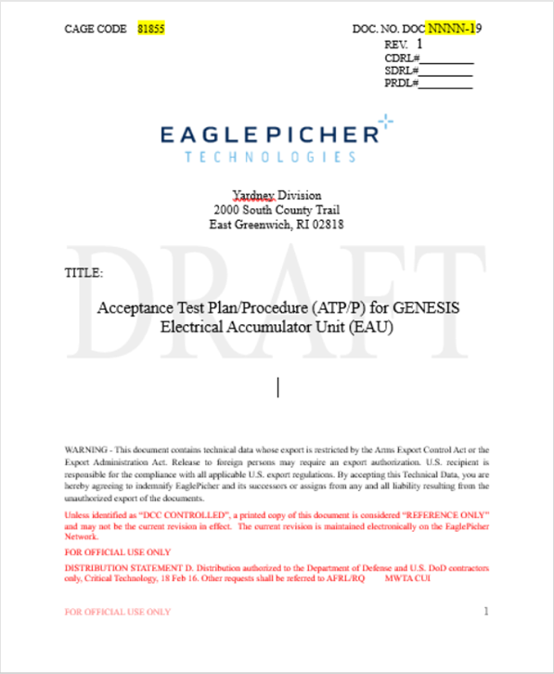
Initial Test Plan
For this PDR phase there is one Acceptance test Plan/Procedure (ATP/P)
Document number TBD.
The Acceptance Test Plan/Procedure is at a high level, i.e. Plan only.
The ATP/P identifies the tests to be performed at the standard level, e.g. 5.1 Level 2 (DC-DC Converter) -40 to +160⁰F Temperature MIL-STD-810F Methods 501.4 (High temperature) Procedure II (Operating, Constant Temperature) and 502.4 (Low Temperature) Procedure II (Operating, constant temperature).
As the program progresses increased detail will be added to the point where there will be a complete detailed procedure.
It is expected that there will be separated procedures developed, for the many tests, along with the accompanying data sheets and test reports.
Testing will be performed IAW ATP/P and the detailed procedures that will follow. Any resulting failures will be analyzed to determine the root cause. Repairs will be made to return the EAU to the test program. It was agreed to by the customer on 2019 Dec 11 that a preliminary test plan is all that is required as exit criteria for PDR.

Slide 70
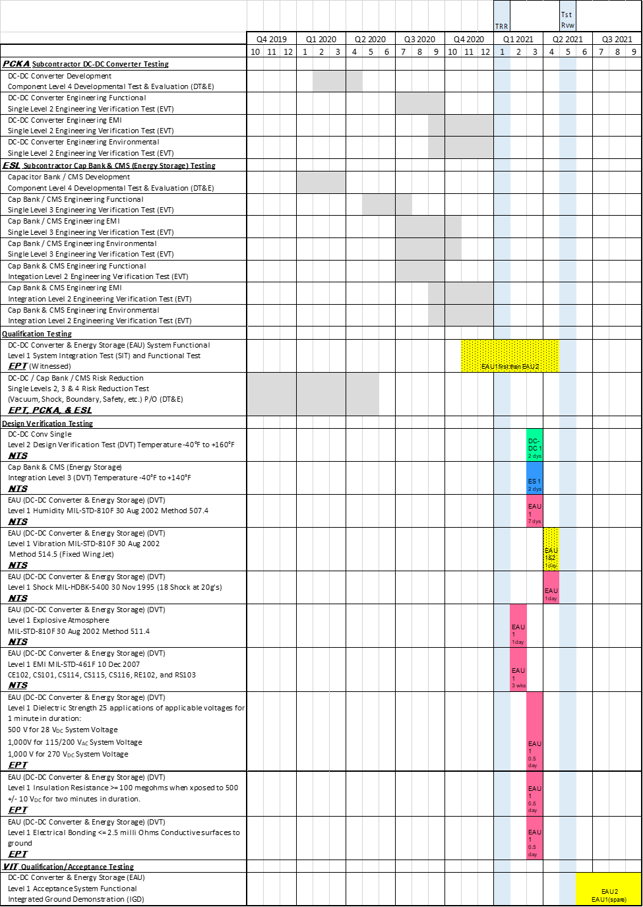
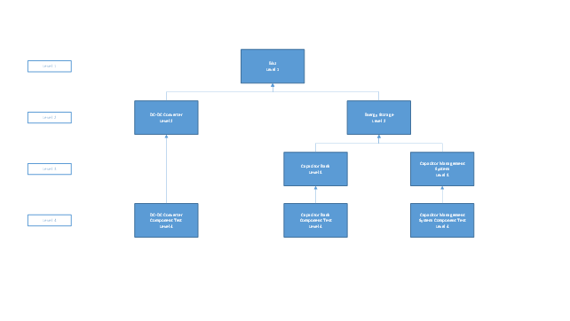
Preliminary Test Facilities/Test configurations
To the right is Table 1 – Overall Program test Activity from the ATP/P
Test facilities are identified in BOLD.
Test configurations e.g. DC-DC Converter Component Level 4 are identified in test description.
Testing will follow the schedule contained in ATP/P resulting in two (2) EAUs for VIT testing per CDRL 3.4m. Customer agreed that EAU 1 will see every test identified in ATP/P while EAU 2 will see qualification op-vibe only.

Slide 71
Test Equipment, instrumentation & Data Acquisition
FP note: Equipment / Location
The preliminary list of test assets listed will be adjusted as required for testing to yield the data required for analysis.

Slide 72
Schedule

Slide 73
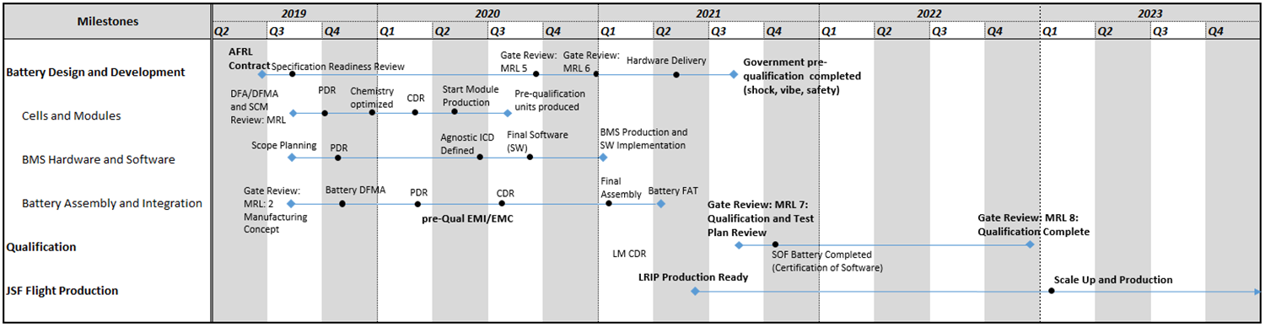
Summarized Schedule (MichaelB to add schedule below)
FP note: Need a real, mpp schedule Alex B can help

Slide 74
Key Deliverables (MichaelB to populate)
Objective:
Complete design, development, and pre-qualification of a 270V battery to integrate with an agnostic interface to the F-35 Joint Strike Fighter
CLIN 1: Conduct research and gather data
CLIN 2: Deliver hardware
Part A: 10 Battery Cell Modules; 18 Individual Battery Cells
Part B: 14 Batteries; 12 Battery Cell Modules (with specified BMS Safety Features per SOW 6.1)
CLIN 3: Non battery hardware and tooling
Support NAVSEA/Crane testing (Test Readiness Reviews)

Slide 75
Quarterly PMR’s and Design Review Schedule (MichaelB content)
Quarterly Management Reviews Summary
Design Reviews Summary
Review Meeting | Location | Estimated Date
QMR Meeting 1 | Wright Patterson | 10/15/2019
QMR Meeting 2 | Joplin, MO | 1/15/2020
QMR Meeting 3 | East Greenwich, RI | 4/15/2020
QMR Meeting 4 | Wright Patterson | 7/15/2020
QMR Meeting 5 | Joplin, MO | 10/15/2020
QMR Meeting 6 | East Greenwich, RI | 1/15/2021
QMR Meeting 7 | Wright Patterson | 4/15/2021
QMR Meeting 8 | Joplin, MO | 7/15/2021
QMR Meeting 9 | East Greenwich, RI | 10/15/2021
Subsystem | Review Meeting | Location | Estimated Date | Int/Ext
Battery | System Requirements Review | Joplin | 8/22/2019 | Ext
BMS | Preliminary Design Review | Joplin | May-20 | Ext
BMS | Critical Design Review | EG | Q2-2021 | Ext
Battery | Acceptance Testing Kickoff | EG | Sep-21* | Ext
Cell and Module | PDR | EG | Dec-19 | Ext
Cell and Module | CDR | EG | Q2-2020 | Ext
Battery | PDR |  | Q2-2020 | Ext
Battery | CDR | EG | Q2-2021 | Ext
Battery (Part A) | TRR |  | Q3-2020 | Ext
Battery (Part B) | TRR |  | Q4-2021 | Ext
*Prototype batteries are scheduled to be built (Q1 or Q2 2021)
Acceptance testing of the deliverable pre-qualification batteries is scheduled for Q4 2021. Which would AFRL be involved in as an Acceptance Test kickoff?

Slide 76
Safety Tests

Slide 77
RogerB to add content

Slide 78
Specification Requirements Review

Slide 79
RogerB to add content

Slide 80
Program Management Plan

Slide 81
Key Stakeholders (MichaelB to add content)
Multi-site Effort
JSF Program Office
Wright Patterson/ Air Force Research Laboratory
Customer lead facility and Program Point of Origin
Lockheed Martin (Fort Worth)
ICD Definition (Effort led by NAVSEA Crane)
NAVSEA Crane
Technical Lead
EaglePicher Locations
East Greenwich:
Cell Development
Battery and Module Assembly
Thermal Modeling
Low Rate Manufacturing
Joplin:
Battery Management System (Hardware and Software)
Manufacturing Ramp

Slide 82
EaglePicher Organizational Structure (Mburke to add content)
Project Organization
FP note: Insert updated org chart

Slide 83
Communication Plan (MichaelB & RogerB to add content)
Documentation will be submitted according to CDRL schedule
File formats and requirements will be standard EP – except where called out in specifically
EP document control and QMS to be utilized for keeping track of documentation and adherence to standards (AS9100 and ISO)
CDRL | Title | Due Date
A001 | Scientific and Technical Reports | Draft: 30 days after TPOP end Final: 90 days after TPOP end
A002 | Funds and Man-Hour Expenditure Report | Monthly
A003 | Contractor Funds Status Report (CSFR) | Quarterly
A004 | Status Reports | Monthly
A005 | Presentation Materials | As Required
A006 | Assessment of Manufacturing Risk and Readiness | 30d after MRL Assessment
A007 | Conference Agenda | As Required
A008 | Conference Minutes | 3 days after PMRs
A009 | Interface Control Document | As Generated
A010 | Interface Requirements Specification | As Generated
A011 | Project Planning Chart | Monthly

Slide 84
Weekly and Bi-Weekly Cadence (MichaelB to add content)
Weekly review of team progress and KPI tracking
Weekly Review (Wednesday afternoon – Thursday Morning)
Mechanical Process Lead
External Stakeholders
Chemical Process Lead
Thursday Afternoon Internal Reviews
EG TPM
AFRL
Bi-weekly Friday Morning Reviews
Systems Engineering Lead
JPO
Manufacturing Operations
Program Lead
NAVSEA CRANE
Hardware Dev. Lead
JP TPM
Lockheed Martin
Software Dev. Lead
ICD Int. Proj. Team
CRANE PM
ICD Cadence to be established as part of EPT/LM subcontract implementation

Slide 85
Data Management Plan (FP note: who has this)
Quality Management System
Internal EP process for managing documentation and manufacturing traceability
Utilizes PDM software and ERP system for version control
PDP Phase reviews will be audited by EPT’s centralized Quality Assurance team
File formats
Standard formats will be utilized to communicate reports
MS Office
.pdf
Password protected as necessary
Configuration Control
Will adhere to LM standards
DOORS software used to manage flow-down of customer requirements (linkage to sub-tier requirements)

Slide 86
Program Metrics
Earned Value Management
In line with CDRL A002 – Contract Funds and Expenditure Report
Key Metrics
Direct and Indirect Cost to Date
Total Hours (Salaried and Hourly)
Materials and Services Expenditures
Progress Trend (Percent Complete relative to schedule and program deliverables)
Estimate To Completion
Based on variance – should also include analysis of deviations and risk analysis/mitigation

Slide 87
Action Items

Slide 88
Action Items Review

Slide 89
Backup Slides

